Slide 1
Access Control & Intrusion Detection
CYS335

Slide 2
Intrusion Detection & Prevention systems
CHAPTER ONE

Slide 3
INTRUSION DETECTION SYSTEMS
UNIT 1

Slide 4
HISTRORY OF INTRUSION DETECTION SYSTEMS
System administrators performed intrusion detection by sitting in front of a console and monitoring user activities.
Although effective enough at the time, this early form of intrusion detection was ad hoc and not scalable.
The next step in intrusion detection involved audit logs, which system administrators reviewed for evidence of unusual or malicious behavior.
As storage became cheaper, audit logs moved online and researchers developed programs to analyze the data.
In the early '90s, researchers developed real-time Intrusion Detection Systems that reviewed audit data as it was produced.

Slide 5
Intrusion Detection Overview
A device that generates alerts when it observes potentially malicious traffic is called an Intrusion Detection System (IDS).
IDSs can be software applications that are installed on endpoints or dedicated hardware devices that are connected to the network.
The goal of intrusion detection is seemingly simple, to detect intrusions.
If there is no manifestation or if the information it contains is untrustworthy, then the system cannot detect the intrusion.

Slide 6
Detection techniques
Anomaly Detection
Creates a traffic profile as it observes traffic in normal operation.
It then looks for packet streams that are statistically unusual.
The great thing about anomaly-based IDS systems is that they don’t rely on previous knowledge about existing attacks.
Anomaly detection uses models of the intended behavior of users and applications, interpreting deviations from this "normal" behavior as a problem.
A basic assumption of anomaly detection is that attacks differ from normal behavior.
The main advantage of anomaly detection systems is that they can detect previously unknown attacks.
In actual systems, however, the advantage of detecting previously unknown attacks is paid for in terms of high false positive rates.

Slide 7
Detection techniques (Continues…)
Misuse Detection
Essentially define what's wrong.
They contain attack descriptions (or "signatures") and match them against the audit data stream, looking for evidence of known attacks.
The main advantage of misuse detection systems is that they focus analysis on the audit data and typically produce few false positives.
The main disadvantage of misuse detection systems is that they can detect only known attacks for which they have a defined signature.
As new attacks are discovered, developers must model and add them to the signature database.

Slide 8
Detection techniques (Continues…)
Signature-based Detection
Maintains a database of attack signatures against which it compares network packets.
If a packet triggers a match to one of the signatures, the IDS flags it.
In other words, a signature-based IDS is completely blind to new attacks that have yet to be recorded.

Slide 9
Detection techniques (Continues…)
Hybrid Detection Method
Uses both Signature and Anomaly-based intrusion detection methods.
However, the main reason behind the development of a hybrid detection system is to identify more potential attacks with fewer errors.

Slide 10
Top Intrusion Detection System Tools
McAfee
Is an IDS designed to identify real-time malicious activities.
It uses both signature and anomaly methods to identify the threats with emulation techniques.
Therefore, McAfee is a scalable application.

Slide 11
Top Intrusion Detection System Tools (Continues…)
Suricata
It is an open-source tool based on a Network Intrusion Detection System (NIDS).
It detects identified threats and malicious activity in real-time.
It uses a Signature-based method to identify the known threats or intrusion.

Slide 12
Top Intrusion Detection System Tools (Continues…)
Cisco Stealthwatch
Cisco designed Stealthwatch with NIDS and HIDS.
It is compatible with Windows, Linux, and MacOS operating systems.
it uses machine learning to create baselines of patterns which is acceptable.
One of the best features of this tool is that it can also detect intrusion and suspicious activities in the encrypted network without decrypting it.

Slide 13
Response: After the intrusion
An intrusion detection system's response is its output or action upon detecting a problem.
A response can take many different forms; the most common is to generate an alert that describes the detected intrusion.
There are also more aggressive responses, such as sounding a siren, or even mounting a counter-attack.
A counterattack might include reconfiguring a router to block the attacker's address or even attacking the culprit.
Obviously, aggressive responses can be dangerous, since they could be launched against innocent victims.

Slide 14
Type of Threats
Internal Threats
The term “internal attack” is used to describe an attack being implemented from a person or organization with some level of authorized access on your network.
Internal attacks are performed from within the trusted area of the network.

Slide 15
Type of Threats (Continues…)
External Threats
Includes anyone that doesn’t have authorized access to the internal network but attempts to gain access.
External threats are what companies spend the most time and money trying to prevent.

Slide 16
Need of Intrusion Detection Systems (IDS)
Monitor inbound and outbound network traffic.
Analyze the patterns in the network continuously.
Send an alarm immediately after detecting unwanted intrusion and activities in the network.

Slide 17
types of Intrusion Detection Systems
Network Intrusion Detection System (NIDS)
NIDS monitors the traffic on the network from all devices.
Similarly, it examines the traffic passing on the entire subnet and verifies it with the packet metadata and content.
If NIDS detects any intrusion in the network, a warning alert is sent to the admin of that network.
Instead of analyzing information that originates and resides on a computer, network-based IDS uses techniques like “packet-sniffing” to pull data from TCP/IP or other protocol packets traveling along the network.

Slide 18
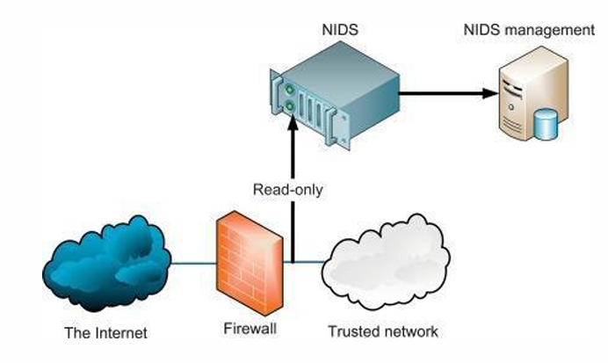
types of Intrusion Detection Systems (Continues…)
NIDS usually require promiscuous network access in order to analyze all traffic, including all uncast traffic.
The NIDS sniffs the internal interface of the firewall in read-only mode and sends alerts to a NIDS Management server via a different (i.e., read/write) network interface.

Slide 19
types of Intrusion Detection Systems (Continues…)
Host Intrusion Detection System (HIDS)
Organizations install a HIDS on independent networked devices.
HIDS examines the incoming and outgoing traffic of the device only.
It detects suspicious activities on the device and alerts the administrator.
its network card operates in no promiscuous mode.
No promiscuous mode of operation can be an advantage in some cases, because not all NICs are capable of promiscuous mode.
Promiscuous mode can be CPU intensive for a slow host machine.

Slide 20
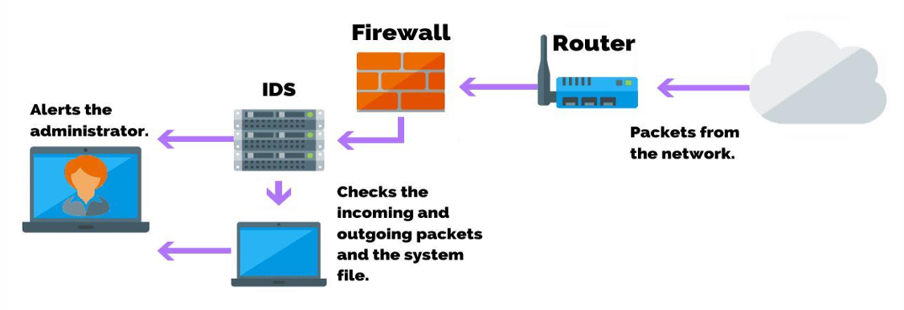
types of Intrusion Detection Systems (Continues…)
Many host-based IDSs depend on signature or string matching to detect threats, and they can be defeated by simply changing a tool enough that the signature no longer matches.
Host-based systems were the first type of IDS to be developed and implemented.
These programs are highly effective for detecting insider abuses.

Slide 21
types of Intrusion Detection Systems (Continues…)
Protocol-based Intrusion Detection System (PIDS)
Organizations set up a PIDS at the front end of the server.
It interprets the protocols between the server and the user.
PIDS monitors the HTTPS server regularly to secure the web.

Slide 22
types of Intrusion Detection Systems (Continues…)
Application Protocol-based IDS (APIDS)
Similarly, APIDS is set up within a group of servers.
It interprets communication with the applications within the server to detect the intrusion.

Slide 23
types of Intrusion Detection Systems (Continues…)
Hybrid Intrusion Detection System
is a mixture of two different IDS (host agents with network information).
Hybrid System is more responsive and effective as compared to other IDS.

Slide 24
Intrusion Prevention Systems (IPS)
Unit 2

Slide 25
Intrusion Prevention Systems
IPS is a form of network security that works to detect and prevent identified threats.
The IPS reports these events to system administrators and takes preventative action, such as closing access points and configuring firewalls to prevent future attacks.

Slide 26
How Do Intrusion Prevention Systems Work?
Intrusion prevention systems work by scanning all network traffic.
The IPS performs real-time packet inspection, deeply inspecting every packet that travels across the network.
If any malicious or suspicious packets are detected, the IPS will carry out one of the following actions:
Terminate the TCP session
Reconfigure the firewall
Remove or replace any malicious content

Slide 27
HOW DO INTRUSION PREVENTION SYSTEMS DETECT MALICIOUS ACTIVITY?
Signature-based Detection
Involves a dictionary of uniquely identifiable signatures located in the code of each exploit.
Exploit-facing – detect malicious activity based on common attack patterns.
Vulnerability-facing – attempt to detect malicious activity by identifying specific vulnerabilities.

Slide 28
HOW DO INTRUSION PREVENTION SYSTEMS DETECT MALICIOUS ACTIVITY? (Continues…)
Statistical Anomaly-based Detection
Detection randomly sample network traffic and then compare the samples to a predetermined baseline performance level.

Slide 29
Types of Prevention
Signature-Based – uses predefined signatures of well-known network threats.
Anomaly-Based – monitors for any abnormal or unexpected behavior on the network.
Policy-Based – This approach requires administrators to configure security policies according to organizational security policies and the network infrastructure.

Slide 30
Types of INTRUSION PREVENTION SYSTEM (IPS)
Network-based Intrusion Prevention System (NIPS) – This type of intrusion prevention system has the ability to monitor the whole network and look for suspicious traffic by reviewing protocol activity.
Wireless Intrusion Prevention Systems (WIPS) – Only monitor wireless networks for suspicious activity by reviewing wireless networking protocols.
Network Behaviour Analysis (NBA) – Looks at network traffic in an effort to locate threats that cause unusual traffic flows, including distributed denial of service (DDoS) attacks and policy violations.
Host-based Intrusion Prevention System (HIPS) – Is an installed software package that looks into suspicious activity that occurs within a single host.

Slide 31
Anatomy of Intrusion Analysis
Pre-Processing – The data is collected about the intrusions, vulnerabilities and attacks and then it is putted down into classification scheme or pattern descriptors.
Analysis – Once the processing is completed, the analysis stage begins. The analysis engine looks for defined patterns that are known as attacks.
Response – The inline sensor can provide real time prevention through an automated response.
Refinement – This gives the opportunity to reduce false-positive levels and to have a more accurate security tool.

Slide 32
What is a vulnerability assessment?
A vulnerability assessment is the process of defining, identifying, classifying and prioritizing vulnerabilities in computer systems, applications and network infrastructures.
The process is sometimes referred to as vulnerability assessment/penetration testing, or VAPT.
Importance of vulnerability assessments include –
Provides an organization with details on any security weaknesses (Vulnerability Identification)
Assess the risks associated with those weaknesses (Risk Assessment).
Strengthening the Security Posture

Slide 33
Types of vulnerability assessments
Network-based scans – are used to identify possible network security attacks.
Host-based scans – are used to locate and identify vulnerabilities in servers, workstations or other network hosts.
Application scans – test websites to detect known software vulnerabilities and incorrect configurations in network or web applications.

Slide 34
Credential analysis non credential analysis
Credential-based Vulnerability Assessments – which make use of the admin account, do a more thorough check by looking for problems that cannot be seen from the network.
Non-credentialed Scans – provide a quick view of vulnerabilities by only looking at network services exposed by the host.

Slide 35
Snort
Unit 3

Slide 36
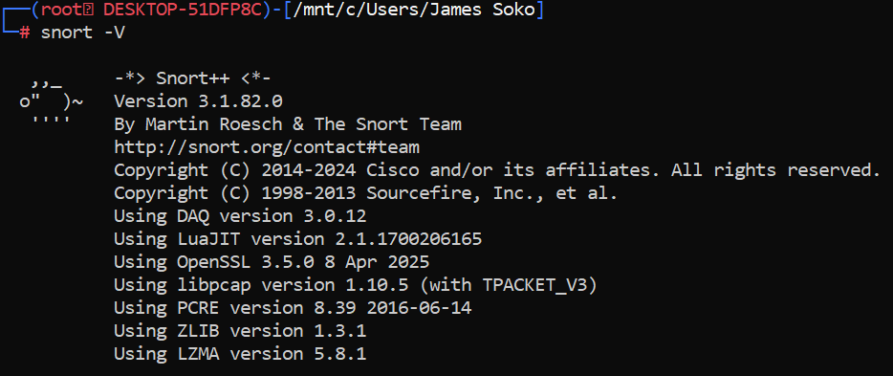
Introduction to Snort
Snort is an open-source network based Intrusion Detection System (IDS) which is written in C programming language.
It was developed in 1998 by Martin Roesch.
Now it is developed by Cisco.

Slide 37
Snort Features
It is based on library packet capture tool.
Its features include:
Real-time traffic monitor – used to monitor the traffic that goes in and out of a network.
Content matching – collates rules by the protocol.
Creates logs
Default and Local Rules

Slide 38
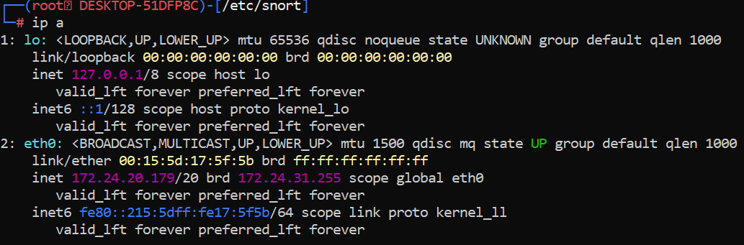
Setting Up Your Home Network
Identify your active network interface.
Alternatively, you can use ifconfig and ip addr.

Slide 39
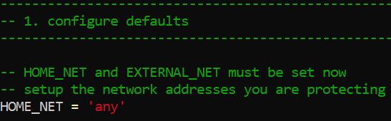
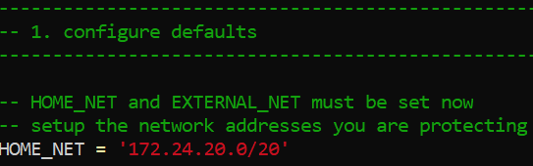
Setting Up Your Home Network (Continues…)
Edit the snort.lua or snort.conf file using nano command.
From
To

Slide 40
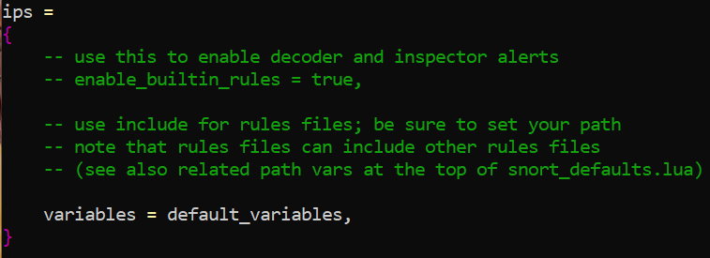
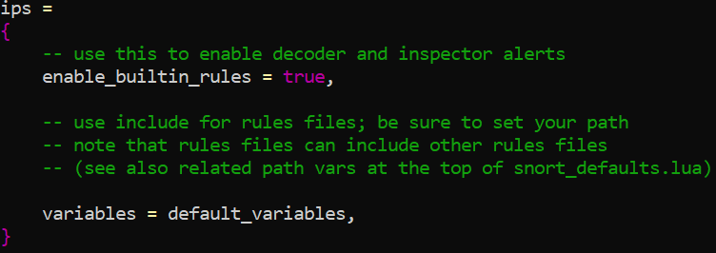
Packet Sniffing Mode Configurations
Edit the snort configuration file with nano snort.lua or nano snort.conf
From To

Slide 41
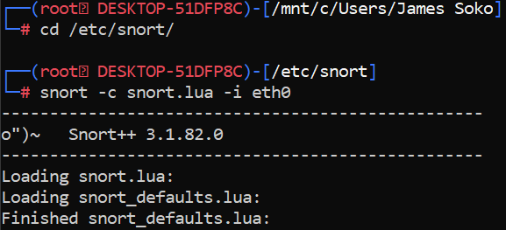
Snort Command Line Options
Run Snort in packet sniffing mode using the configuration file.
-c allows you to specify which configuration file you want to use. In snort v3 snort.lua is used while in v2 snort.conf is used.
-i specifies which interface Snort should listen on e.g., Ethernet (eth0)

Slide 42
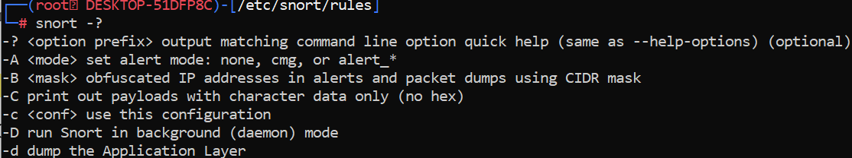
Snort Command Line Options (Continues…)
-V displays the Snort version number and then exits.
-? lists all switches and options and then exits.

Slide 43
Snort Command Line Options (Continues…)
Snort itself uses something called Data Acquisition library (DAQ) to make abstract calls to packet capture libraries.
Run Snort in inline mode (ensure interface and bridge setup if required)
--daq afpacket tells Snort to use the AFPacket DAQ module.
-Q enables inline mode (for IPS).

Slide 44
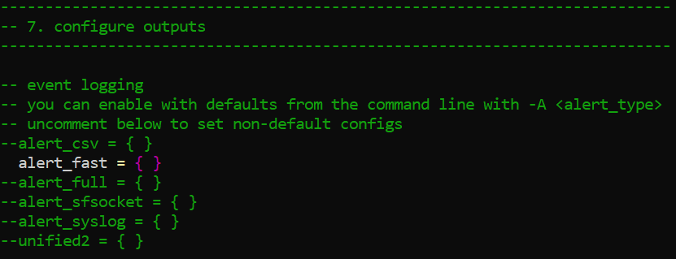
Snort Alert Modes
You can view these snort alert modes via nano /etc/snort/snort.lua in v3 and /etc/snort/snort.conf in v2.

Slide 45

Snort Alert Modes & Snort Command Line Options (Continues…)
Fast
-A generates an alert using one of the specified alert-modes: fast, full, none, and unsock.
Snort alerts report the timestamp, send an alert message, show the source and destination IP address and port.

Slide 46
Snort Alert Modes (Continues…)
Full
Is the default alert mode.
Additionally to the information printed in the fast mode, the full mode shows the TTL, packet headers and datagram length, service, ICMP type, window size, ACK and sequence number.
Console – prints fast alerts in the console.

Slide 47
Snort Alert Modes (Continues…)
None – With this mode, Snort does not generate alerts.
Unsock – This is useful to export alert reports to other programs through Unix sockets.
Cmg – This alerts mode was developed by Snort for testing purposes; it prints a full alert on the console without saving logs.

Slide 48
Snort Rules
Unit 4

Slide 49
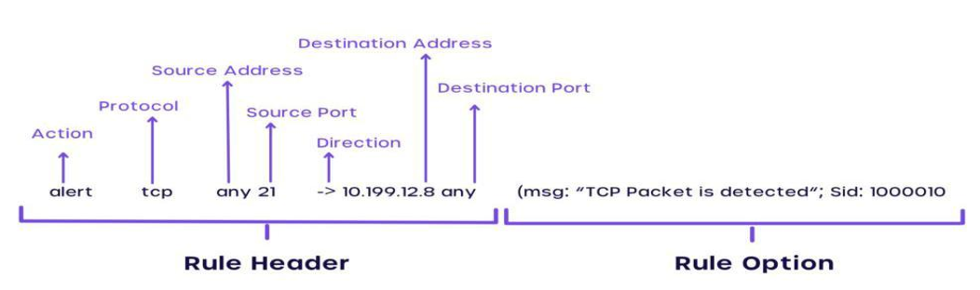
Working with Snort Rules
Provide a sample Snort rule to detect HTTP traffic on port 80 and explain its structure.
Navigate to nano /etc/snort/rules/local.rules

Slide 50
Rule Header
Action
alert – alerts the network administrator upon detecting a potential threat.
drop – used in IPS (Intrusion Prevention System) mode to block malicious traffic.
pass – ignores the packet.
log – records packet data (headers and payload) but does not alert.
activate – generates an alert and then activates another rule (a dynamic rule).
dynamic – does nothing until activated by an activate rule.
reject – drops the packet and sends a TCP reset (for TCP) or ICMP unreachable (for UDP/ICMP).
sdrop (Silent Drop) – silently drops the packet without alerting or logging.

Slide 51
Rule Header (Continues…)
Protocol – you may key in the Protocol address that you need e.g., tcp.
Source IP Address – For example, 172.24.20.0 or any
Source Port – computers generally have 65,536 TCP Ports (e.g., 80 for HTTP) and if you wish, you may again key-in ‘any’ to define all such ports in the rule.
Flow – refers to the direction of the traffic and denoted by ->
Destination IP Address
Destination Port

Slide 52
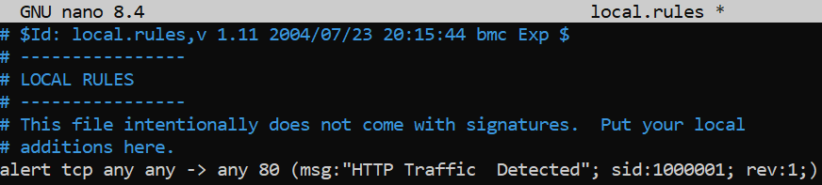
Working with Snort Rules (Continues…)
Below is our local rule:
msg is the message displayed after the detection.
sid is the snort ID (below 1 million for default rules and above that are local rules)
rev is the revision number.

Slide 53
Snort Rules Examples and Cheat sheet
NOTE:
You can replace any with an IP Address e.g., 172.24.20.0/24 or port e.g., 21
You can also replace the IP Address 172.24.20.0/24 with $HOME_NET
You can also replace any with $EXTERNAL_NET if specified in the configuration file.

Slide 54
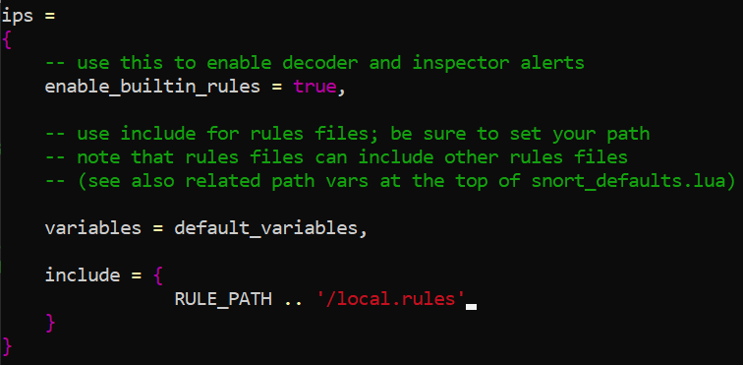
Configuring Local Rules
Edit the snort configuration file and include the local rule path.

Slide 55

Snort Command Line Options (Continues…)
Test your snort configurations for any errors.
-T starts Snort in self-test mode. Useful for debugging Snort before it is run in daemon mode or before it is launched on a production box. Can be used for testing the correctness of your configuration files.

Slide 56
The Snort Configuration File
A sample configuration file snort.conf is included in the Snort distribution.
You use the -c command line switch to specify the name of the configuration file.
This file contains six basic sections (KEYWORD: PROP AV):
Parameter, Rule, Output, Preprocessor, Action, Variables (PROP AV)
Variable definitions – where you define different variables.
Configure parameters – specify different Snort configuration options.

Slide 57
The Snort Configuration File (Continues…)
Preprocessor configuration – are used to perform certain actions before a packet is operated by the main Snort detection engine.
Output module configuration – control how Snort data will be logged.
Defining new action types
Rules configuration and include files – These files are then included inside the main configuration file using the include keyword.

Slide 58
Analysis Console for Intrusion Databases (ACID)
Unit 5

Slide 59
NOTICE
The slides will be added before Monday, for now study the lecture slides.

Slide 60
Access Control
Chapter Two

Slide 61
What Is Access Control?
Granting or denying approval to use specific resources.
Identification – Presenting credentials.
Authentication – Checking the credentials.
Authorization – Granting permission to take action.
Access – Right given to access specific resources.

Slide 62
Access Control Terminology
Object – Specific resource (e.g., file)
Subject – User or process functioning on behalf of a user (i.e., computer user)
Operation – Action taken by the subject over an object (e.g., deleting a file)

Slide 63
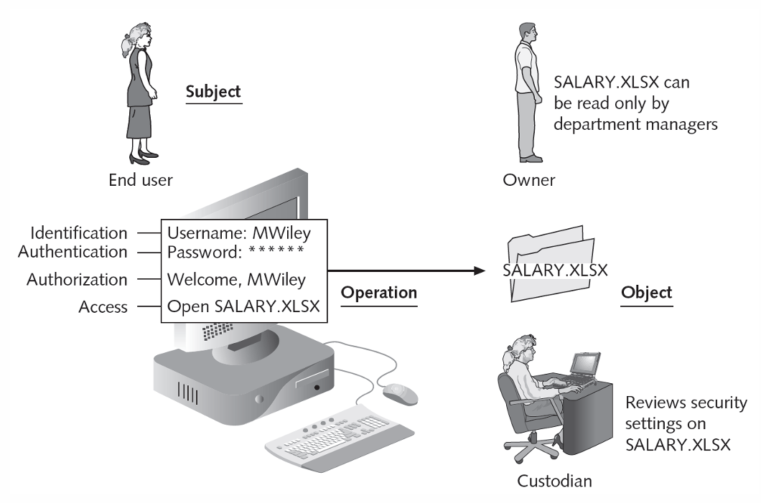
Access Control Terminology (Continues…)
Owner – Determines the level of security needed to the data.
Custodian – Assigned by the owner to review security settings.
End User – Accesses the information and does not circumvent security based on the organizations guidelines.

Slide 64
Access Control Models
Mandatory Access Control (MAC)
Most restrictive access control model.
Typically found in military settings.
It has two elements –
Labels – indicate level of privilege
Levels
MAC grants permissions by matching object labels with subject labels.
To determine if file may be opened:
Compare object and subject labels
Subject must have equal or greater level than object to be granted access

Slide 65
Access Control Models (Continues…)
Two major implementations of MAC
Lattice model –
Bell-LaPadula – Subjects may not create a new object or perform specific functions on lower level objects.

Slide 66
Access Control Models (Continues…)
Discretionary Access Control (DAC)
Least restrictive model.
Every object has an owner.
Owners have total control over their objects.
Owners can give permissions to other subjects over their objects.

Slide 67
Access Control Models (Continues…)
Role Based Access Control (RBAC)
Also called Non-discretionary Access Control.
Access permissions are based on user’s job function.
Rule Based Access Control (RBAC)
Dynamically assigns roles to subjects based on a set of rules defined by a custodian.

Slide 68
Best Practices for Access Control
Separation of duties – Fraud can result from single user being trusted with complete control of a process.
Job rotation – Limits amount of time individuals are in a position to manipulate security configurations.
Least privilege – Helps reduce attack surface by eliminating unnecessary privileges.
Implicit deny – If a condition is not explicitly met, access request is rejected.

Slide 69
Access Control Lists
Set of permissions attached to an object.
When subject requests to perform an operation, system checks ACL for an approved entry.
Each entry in the ACL table is called Access Control Entry (ACE).

Slide 70
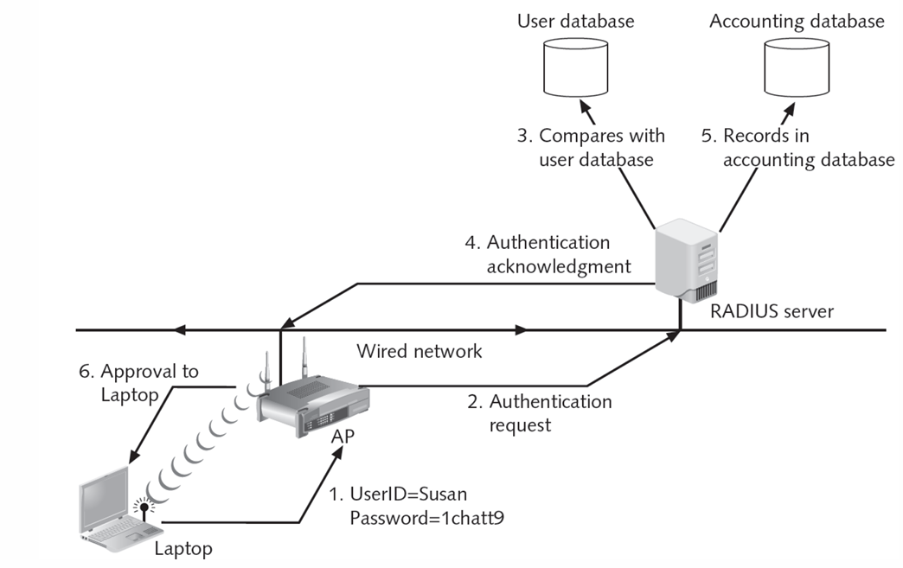
Authentication Services
Authentication is process of verifying credentials.
Remote Authentication Dial-In User Service (RADIUS)
Developed in 1992
RADIUS client are devices such as a Wireless AP responsible for sending user credentials and connection parameters to the RADIUS server.

Slide 71
Terminal Access Controller Access
Control System Plus (TACACS+)
Terminal Access Controller Access Control System Plus (TACACS+)
Is an authentication service similar to RADIUS which was developed by Cisco Systems.
Feature | RADIUS | TACACS+
Protocol | UDP | TCP
Transport Characteristics | Connectionless, faster but less reliable | Connection-oriented, more reliable
Encryption | Encrypts the password in the packet | Encrypts the entire packet payload
Authentication & Authorization | Combined Processes | Separate Processes
Typical use | Remote user network access authentication | Device administration (routers, switches)

Slide 72
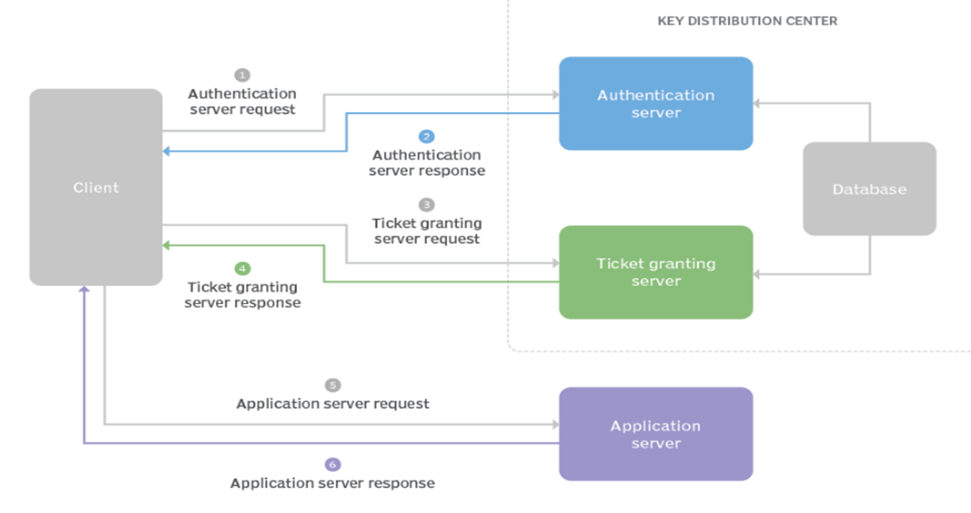
Authentication Services (Continues…)
Kerberos
Authentication system developed at MIT.
Uses encryption and authentication for security.
Kerberos is a protocol for authenticating service requests between trusted hosts across an untrusted network, such as the internet.

Slide 73
Authentication Services (Continues…)
Lightweight Directory Access Protocol (LDAP)
Keeps track of network resources and user’s privileges to those resources.
LDAP is a simpler subset of DAP which was designed to run over TCP/IP.
Grants or denies access based on its information.
X.500 standard defines protocol for client application to access the DAP.
Weakness of LDAP can be subject to LDAP injection attacks.

